Slide 1
The Role of External Review Activities in Supporting Sustainable Quality Systems in Higher Education
Dr Tess Goodliffe
Deputy CEO Technical Affairs
Oman Academic Accreditation Authority

Slide 2
Content
Types of External Review Activities
Purpose of External Review Activities
What is a sustainable quality system?
Features of a sustainable quality system
The Oman context
About the OAAA
How does the OAAA support a sustainable quality system?
Challenges
Conclusions

Slide 3
Types of External Review Activities
Institutional/program level
Mandatory/voluntary
National/international/professional
Affiliate driven/peer driven/external body driven
Standards-based/self-study based
Result in formative/summative outcomes

Slide 4
Purpose of external review activities
[External review activities] have come to serve a wide range of purposes, which include:
Based on Jan Kohouteck (2009) http://unesdoc.unesco.org/images/0018/001886/188647e.pdf p.23
Sustaining and enhancing the quality in higher education particularly in terms of serving as a gatekeeper for a threshold level of quality
Acting as a primary incentive for institutional/programme
quality development
Acting as a provider of an exchange of expertise through panel activity and supporting regional and national fora on higher education quality

Slide 5
A sustainable quality system
A system that is able to be maintained at a certain rate or level
(Oxford English Dictionary)

Slide 6
What are the features of a sustainable
quality management system?
systemic
v
ad hoc
proactive
v
reactive
contextual
v
general
documented
v
tacit knowledge
consistent
v
inconsistent
governed
v
managed
internally driven
assurance
+
enhancement

Slide 7
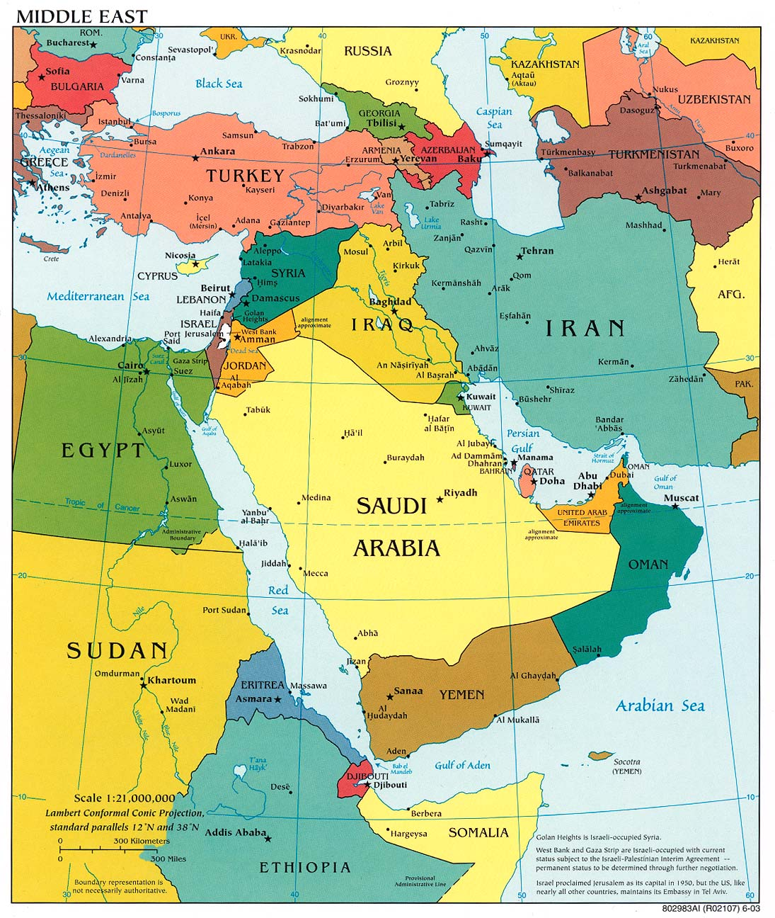
Oman Context
Ruler: Sultan Qaboos bin Al Said (since 1970); monarchy with two advisory councils (one of which is elected)
Population: Total 3.855 million:
2.172 million Omanis (48% under 19)
1.683 million non-Omanis
(growth rate of 6.4%)
Main income: Oil and gas continue to be an important source of revenue: 84% in 2013 (9.32bn OMR)

Slide 8
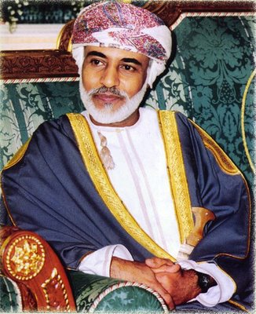
...nations are built solely by the hands of citizens. Progress and prosperity can only be achieved through learning, experience, training and qualifications ... the real wealth of any nation is made up of its human resources. They are the power that achieves development in all walks of life...
(HM Speech to the Council of Oman, 2001)

Slide 9
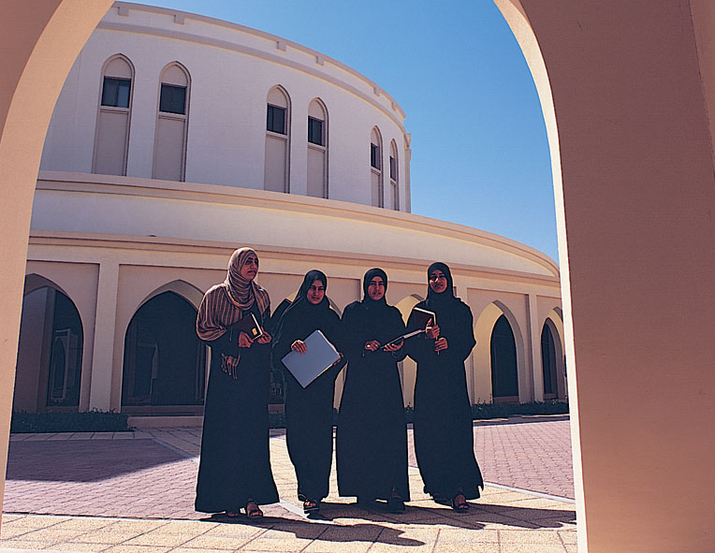
In 2015, there are around 1250 public and private schools and more than 60 public and private institutions offering post secondary education

Slide 10
Responsibility for Quality in Oman’s HE sector
10

Slide 11
About the OAAA
Originally established as the Oman Accreditation Council in 2001
An independent governmental entity established to provide confidence to the public that the quality of higher education in Oman meets international standards, and to encourage continuous improvement in the management of the quality of higher education.
Responsible for developing a national system of institutional and program accreditation for public and private sector HEIs
Program accreditation includes foreign as well as Omani programs
  Responsible for updating and maintaining the national qualifications framework

Slide 12
OAAA Vision and Mission
OAAA Vision
OAAA aspires to be an internationally recognized authority for accreditation and promotion of quality in higher education in Oman.
OAAA Mission
To encourage and support the Omani higher education sector in meeting international standards; to maintain the national qualifications framework; and, through a transparent rigorous system of institutional and program accreditation, provide reliable information to the public and other stakeholders on the quality of higher education in Oman.
12
Notes:
12

Slide 13
OAAA HEI QA Processes
First cycle
commenced
HEI Accreditation
HEI Licensure
2008
Stage
1
:
Quality
Audit
4 years
≤4 years
Appeal
HEI Accreditation
HEI Accreditation
Certificate
Met
Stage
2
:
Standards
Assessment
KEY
Not met
1-2 years on
Probation
Start/End
Process
Met
HEI Standards
HEI
Accreditation
Terminated
Reassessment
Document
Notes:
13

Slide 14
How does OAAA support a sustainable quality system?
systemic
v
ad hoc
Two-stage accreditation cycle will monitor the ongoing implementation of an HEI’s quality system; standards call for systemic approaches
proactive
v
reactive
Self-study activities help HEIs to identify OFIs; the use of ADRI as an evaluative tool by HEIs and Panels focuses on the effectiveness of a planned approach

Slide 15
How does OAAA support a sustainable quality system?
contextual
v
general
Both Quality Audits and Standards Assessments recognise the diversity of HE provision and the importance of contextualising quality systems for Oman
documented
v
tacit knowledge
Evidence-based approaches to external review activities call for a documented approach, e.g. manuals, policies and guidelines; visits help explore the awareness and usage of these

Slide 16
How does OAAA support a sustainable quality system?
consistent
v
inconsistent
Institutional accreditation explores whether quality systems are implemented throughout an HEI and how this is continuously monitored
governed
v
managed
Quality systems need to be supported at the highest level of the HEI; buy in from governance bodies is essential and external review activities support this

Slide 17
How does OAAA support a sustainable quality system?
internally driven
External review activities can only go so far; internal commitment within the HEI is essential to ensure that systems are sustainable. OAAA training and use of local reviewers on panels helps to establish a community of practice: a body of professionals committed to quality.
assurance
+
enhancement
Recognition of enhancement through Commendations (in Quality Audit Reports) and possibility of accreditation with merit (at HEI and standard level)

Slide 18
Challenges
Quality systems aren’t an end in themselves; need to keep purpose in sight e.g. Mission of HEI
High turnover of staff affects sustainability of quality system unless there is an embedded, documented approach
Possibility of ‘accreditation fatigue’ and burden on HEIs; danger of ‘bureaucratisation’
Quality systems are dynamic and need to respond to changing needs/demands of HEIs and stakeholders
Danger of staff ‘jumping through hoops’ to satisfy requirements of external review activities
Need to support a diverse, developing sector in meeting international standards

Slide 19
Conclusions
There are a range of external review activities; they will serve a variety of purposes depending on context
There are a number of key features of a sustainable quality system
Different aspects of the external review activities will support different features
OAAA work in Oman provides a case study of how a combination of formative and summative external review activities can support a sustainable quality system as well as drive quality enhancement
Impact of these activities will be measured through a cyclical process of review; agencies also have to have sustainable quality systems.

Slide 20
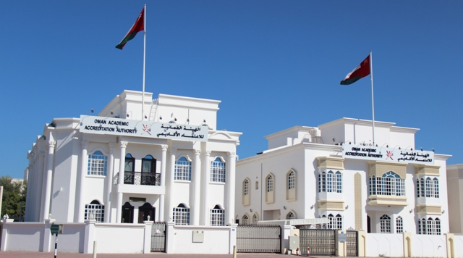
www.oaaa.gov.om
tess@oaaa.gov.om

